Slide 1
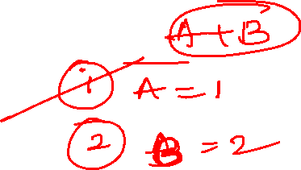
Data Sufficiency
Logical Reasoning

Slide 2
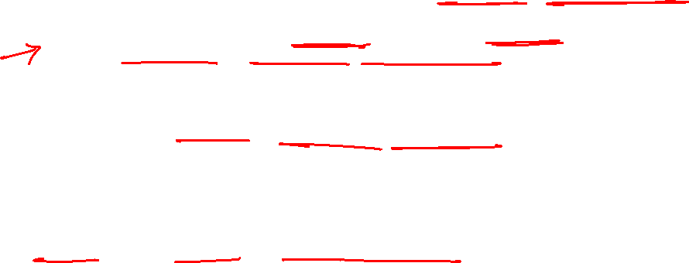
Know Concepts of Data Sufficiency
The first and foremost thing to do is to go through the complete question properly first. This way, you will know, what data is required to arrive at the answer to the given question. After that, proceed to the statements that have been provided.
Don’t forget, you don’t have to solve the question completely.
All you need to do is figure out if the data that has been provided to you is sufficient to answer the question. This saves the time that is spent on calculations or the complete solution.
The step must be: Analyze each statement separately first. There can be two or three statements
If all the statements aren’t providing sufficient information to answer the question, then take the details provided in any two or all the statements and check if the information together is sufficient to answer the question.
Understand the language of the question properly. Don’t make assumptions.
Do not mark the answer after testing just one statement. For instance, even if you conclude that the data in statement 1 is sufficient to answer the question, do not forget to check for the other states.
Use the process of elimination of options to narrow down the possible answers. For instance, if data in statement 1 is sufficient to answer the question, you only need to check for the second statement. Combining the information of the two statements and checking if it would be sufficient to answer the question won’t be required here.
Make sure that you don’t spend too much time on these problems.
Practice these types of questions thoroughly.

Slide 3
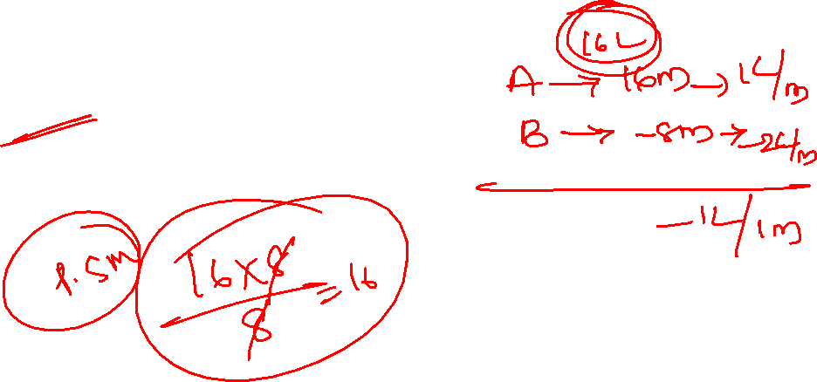
1. How long will it take to empty the tank if both the inlet pipe A and the outlet pipe B are opened simultaneously
Statement I: A can fill the tank in 16 minutes
Statement II: B can empty the tank in 8 minutes
Only Statement I is sufficient
Only Statement II is sufficient
Statement I and II together is sufficient
Statement Either I or II is sufficient
Both I and II together are not sufficient
Notes:
C

Slide 4
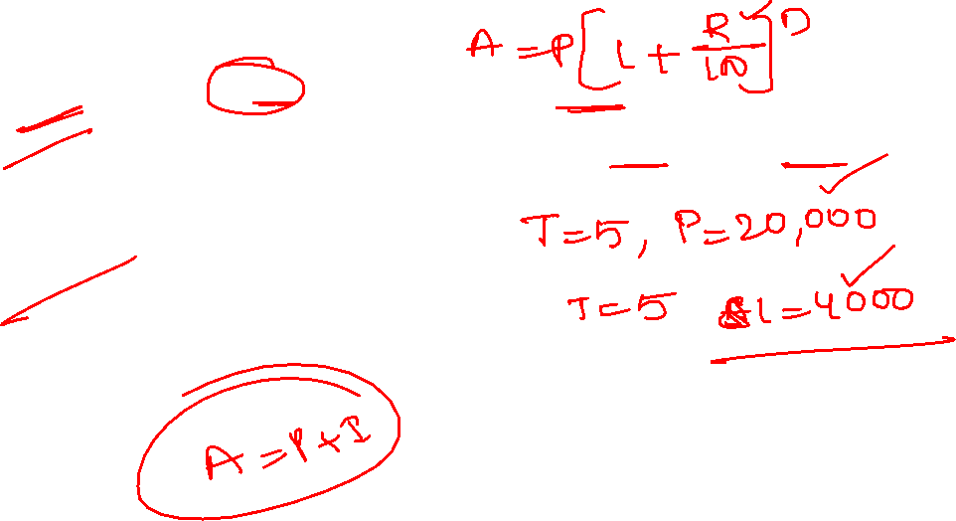
2. What is the total CI on a sum of money after 5 years
Statement I: The sum was Rs. 20,000
Statement II: The total amount of SI on the sum after 5 years was Rs.4000
Only Statement I is sufficient
Only Statement II is sufficient
Statement I and II together is sufficient
Statement Either I or II is sufficient
Both I and II together are not sufficient
Notes:
C

Slide 5
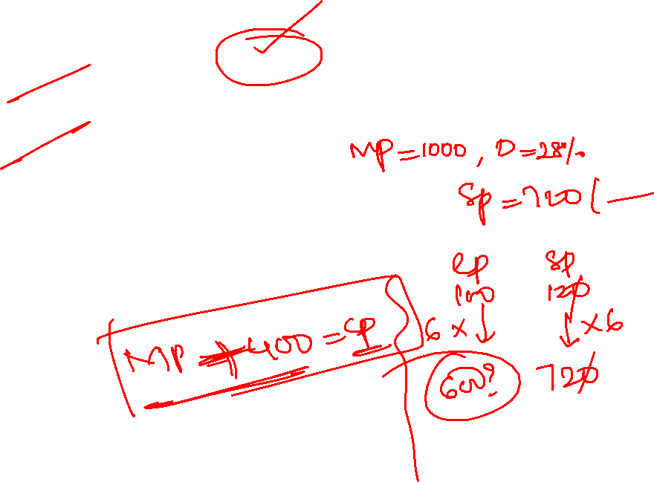
3. An article was sold at 20% profit. Find its cost price.
Statement I: Marked price was Rs. 1000 and discount was 28%
Statement II: Marked price was Rs. 400 more than cost price
Only Statement I is sufficient
Only Statement II is sufficient
Statement I and II together is sufficient
Statement Either I or II is sufficient
Both I and II together are not sufficient
Notes:
A

Slide 6
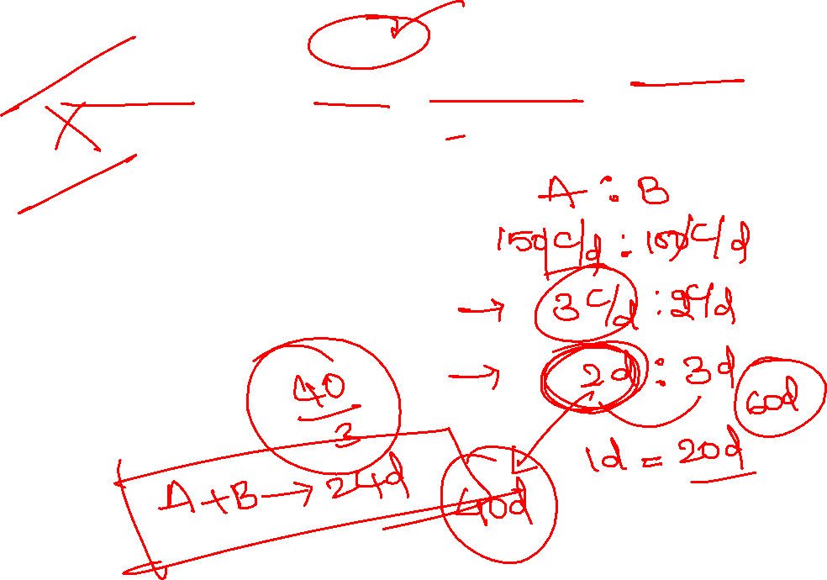
4. What is the time taken by Anjana to complete the work alone?
Statement I: Anjana is 50% more efficient than Bhavna and the difference between the time taken by Bhavna and Anjana is 20 days.
Statement II: Anjana and Bhavna together can complete the work in 24 days
Only Statement I is sufficient
Only Statement II is sufficient
Statement I and II together is not sufficient
Statement Either I or II is sufficient
Both I and II together are sufficient

Slide 7
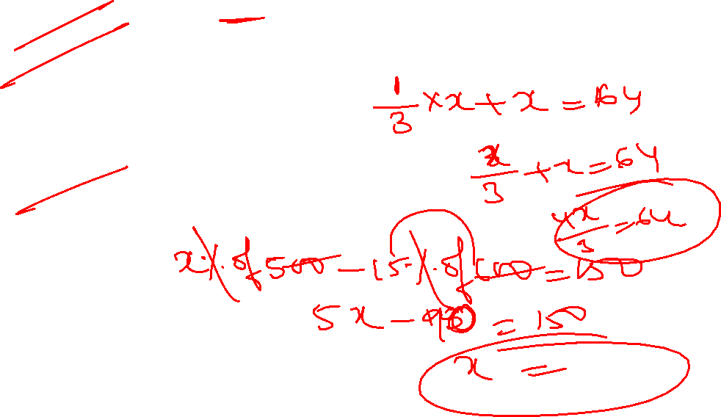
5. What is the value of X?
Statement I: the difference between x% of 500 and 15% of 600 is 150
Statement II: when one-third of x is added to x, the result becomes 64
Only Statement I is sufficient
Only Statement II is sufficient
Statement I and II together is not sufficient
Statement Either I or II alone is sufficient
Both I and II together are sufficient
Notes:
D

Slide 8
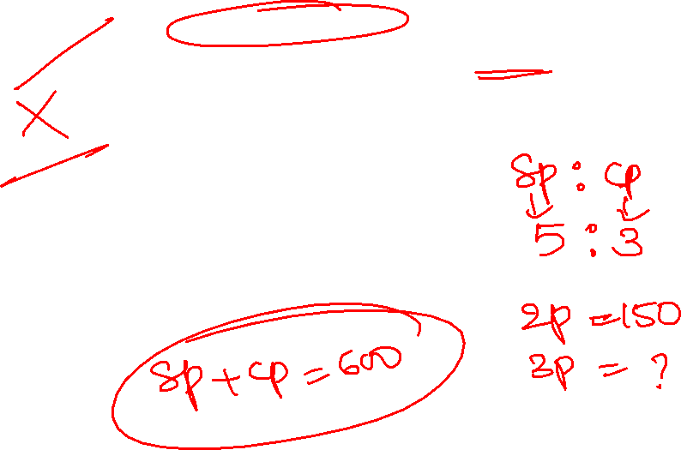
6. What is the cost price of article?
Statement I: the profit earned on the article is Rs 150 and the ratio between selling price and cost price is 5:3
Statement II: The sum of selling price and cost price of the article is Rs. 600
Only Statement I is sufficient
Only Statement I is sufficient
Statement I and II together is sufficient
Statement Either I or II is sufficient
Both I and II together are not sufficient
Notes:
A

Slide 9
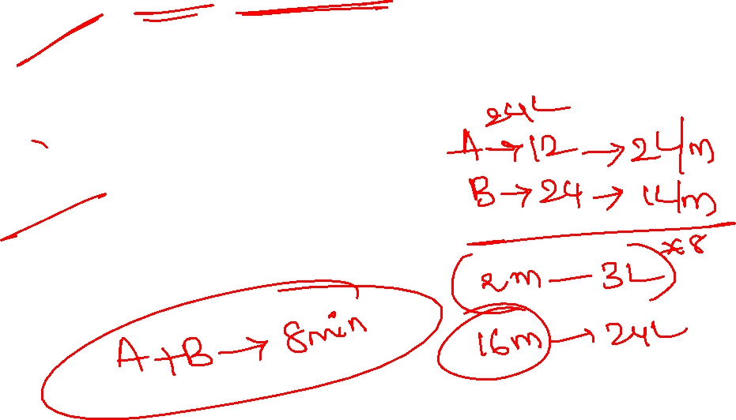
7. If pipe A and B open at alternate minutes, then in how many minutes tank will be filled
Statement I: pipe A alone can fill the tank in 12 minutes and pipe B alone can fill the tank in 24 minutes
Statement II: pipe A and B together can fill the tank in 8 minutes
Only Statement I is sufficient
Only Statement II is sufficient
Statement I and II together is sufficient
Statement Either I or II alone is sufficient
Both I and II together are not sufficient
Notes:
D

Slide 10
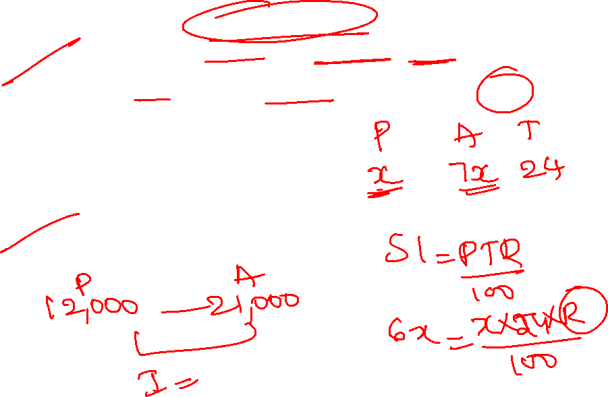
8. What is the rate of interest per annum?
Statement I: A sum of amount becomes 7 times in 24 years at simple interest
Statement II: the amount of Rs. 12,000 becomes Rs 21,000 in 3 years at Simple interest
Only Statement I is sufficient
Only Statement II is sufficient
Statement I and II together is sufficient
Statement Either I or II alone is sufficient
Both I and II together are sufficient
Notes:
D

Slide 11
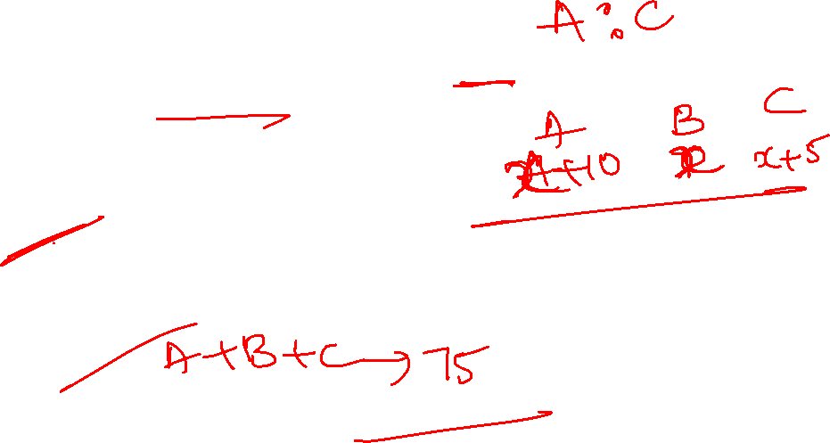
9. Find the ratio of age of A to age of C
Statement I: A is 10 years older than B and C is 5 years younger than A
Statement II: Average age of A, B and C is 25
Only Statement I is sufficient
Only Statement II is sufficient
Statement I and II together is sufficient
Statement Either I or II alone is sufficient
Both I and II together are not sufficient
Notes:
C

Slide 12
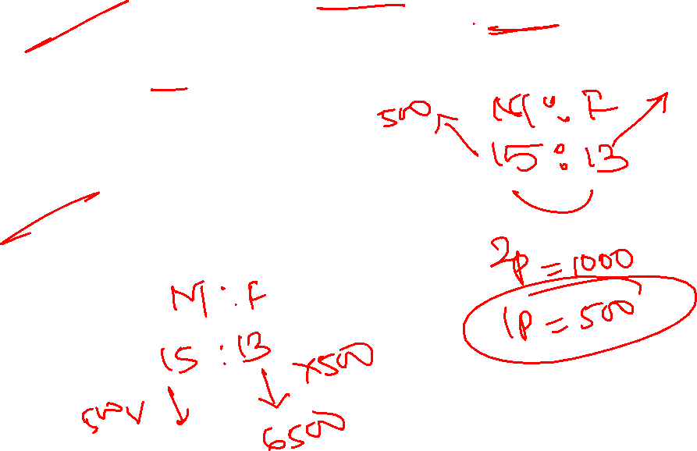
10. The ratio of the population of males to the population of females is 15:13. what is the population of the city?
Statement I: The difference between population of males and the population of females is 1000.
Statement II: The population of females is 6500.
Only Statement I is sufficient
Only Statement II is sufficient
Statement I and II together is sufficient
Statement Either I or II is sufficient
Both I and II together are not sufficient
Notes:
D

Slide 13
11. Find rate of simple interest
Statement I: interest earned Rs 4000
Statement II: Sum invested for 4 years
Only Statement I is sufficient
Only Statement II is sufficient
Statement I and II together is sufficient
Statement Either I or II is sufficient
Both I and II together are not sufficient
Notes:
E

Slide 14
12. Gowtham ranks 18th in a class. What is the rank from the last?
Statement I: There are 47 students in the class
Statement II: Jegan who ranks 10th in the same class, ranks 38th from the last
Only Statement I is sufficient
Only Statement II is sufficient
Statement I and II together is sufficient
Statement Either I or II is sufficient
Both I and II together are not sufficient
Notes:
D

Slide 15
13. Who is the shortest among all?
Statement I: if Meena is taller than Rajesh and Rajesh is taller than veena. Pallavi is not the tallest
Statement II: if Ashok is taller than Sujal and Sujal is not the shortest. Veena is taller than Ashok
Only Statement I is sufficient
Only Statement II is sufficient
Statement I and II together is sufficient
Statement Either I or II is sufficient
Both I and II together are not sufficient
Notes:
C

Slide 16
14. How is L related to J?
Statement I: I is the sister of J.
Statement II: L is the husband of K, who is the sister of J.
Only Statement I is sufficient
Only Statement II is sufficient
Statement I and II together is sufficient
Statement Either I or II is sufficient
Both I and II together are not sufficient
Notes:
B

Slide 17
15. In arow of five buildings A, B, C, D, and E which building is in the middle
Statement I: building D and B are at the two extreme ends of the row
Statement II: Building E is to the right of Building C
Only Statement I is sufficient
Only Statement II is sufficient
Statement I and II together is sufficient
Statement Either I or II is sufficient
Both I and II together are not sufficient
Notes:
E

Slide 18
16. How Ram is related to Mona?
Statement I: Mona’s brother is husband of Poonam
Statement II: Poonam is mother of Ram’s sister.
Only Statement I is sufficient
Only Statement II is sufficient
Statement I and II together is sufficient
Statement Either I or II is sufficient
Both I and II together are not sufficient
Notes:
C

Slide 19
17. On which day is Shyam’s birthday?
Statement I: His Birthday is not on wednesday
Statement II: His birthday is between Monday and Friday
Statement III: his birthday between Wednesday and Sunday
Only Statement I is sufficient
Only Statement III is sufficient
Statement II and III together is sufficient
Statement Either I or II is sufficient
Both I , II and III together are not sufficient
Notes:
C

Slide 20
18. What is the simple interest accrued on a principal of Rs. 25000 in six years?
I. The rate of the simple interest for the first three years is 4 p.c.p.a.?
II. The rate of simple interest for the next three years is 6 p.c.p.a.?
Only Statement I is sufficient
Only Statement II is sufficient
Statement I and II together is sufficient
Statement Either I or II is sufficient
Both I and II together are not sufficient
Notes:
E

Slide 21
19. Five girls are sitting on a bench to be photographed. Who is sitting immediate right of Lata?
Statement I: Radha is to the left of Anvesha and to the right of Mona
Statement II: Natasha is to the right of Anvesha. Lata is between Anvesha and Natasha
Only Statement I is sufficient
Only Statement II is sufficient
Statement I and II together is sufficient
Statement Either I or II is sufficient
Both I and II together are not sufficient
Notes:
C

Slide 22
20. ₹ 310 is divided among three persons Aman, Bharat, and Chandu. Find Aman’s share.
I. Bharat gets Rs 16 more than Chandu
II. Aman gets Rs 3 more than Chandu.
III. Aman gets Rs 13 less than Bharat.
A. Only I and III
B. Only II and III
C. All three
D. III and either I or II
E. Any two of the three statements
Notes:
Ans.E E.
Aman + Bharat + Chandu = 310
From I,
Bharat = Chandu + 16
From II,
Aman = 3 + Chandu
From III,
Aman = Bharat – 13
So from any two of statements I, II, and III the share of any person can be obtained. It will convert into two variables and a 2 equation model.
Hence, option E is correct.

Slide 23
21. The weights of A, B, and C are in the ratio of 8: 7: 5. A’s weight is 60% more than C’s. Find the weight of B.
I. Total weight of A, B, and C is 300 kg.
II. Difference between A’s and C’s weight is 45 kg.
Only Statement I is sufficient
Only Statement II is sufficient
Statement I and II together is sufficient
Statement Either I or II is sufficient
Both I and II together are not sufficient
Notes:
D

Slide 24
22. Question: Ram, Sham, Vinit, Aman, and Manish are sitting in a row. Who is sitting the middle?
Statements:
I. Sham is between Manish and Vinit.
II. Sham is to the right of Manish.
III. Aman is between Ram and Manish.
Only Statement I is sufficient
Only Statement II is sufficient
Statement I and II together is sufficient
Statement Either I or II is sufficient
Both I and II and III together are not sufficient
Notes:
D

Slide 25
23. On which day of the week will Vimal celebrate his birthday?
Statements:
I. It is in February and 21st of February is a Tuesday.
II. It is on the last day of the month.
Only Statement I is sufficient
Only Statement II is sufficient
Statement I and II together is sufficient
Statement Either I or II is sufficient
Data insufficient
Notes:
E

Slide 26
24. What is Rashmi’s rank in the class?
I. There are 25 students in the class.
II. There are 8 students who have scored less than Rashmi.
Only Statement I is sufficient
Only Statement II is sufficient
Statement I and II together is sufficient
Statement Either I or II is sufficient
Both I and II together are not sufficient
Notes:
E

Slide 27
25. On which date of the month was Diksha born in February 2000?
Statements:
I. Diksha was born on an odd date of the month.(Except 1)
II. Diksha's birth date was a single digit number and a perfect square.
Only Statement I is sufficient
Only Statement II is sufficient
Statement I and II together is sufficient
Statement Either I or II is sufficient
Both I and II together are not sufficient
Notes:
As per the given statements Diksha’s birth date was a single digit number which is odd and is a perfect square. The only such number is 9. Thus Diksha birth day falls on 9 February. So, both I and II required answering the given Question.
Hence, option C is the correct answer.

Slide 28


